Slide 1

Make yourself comfortable.
Tea & Coffee available at the back.

Slide 2
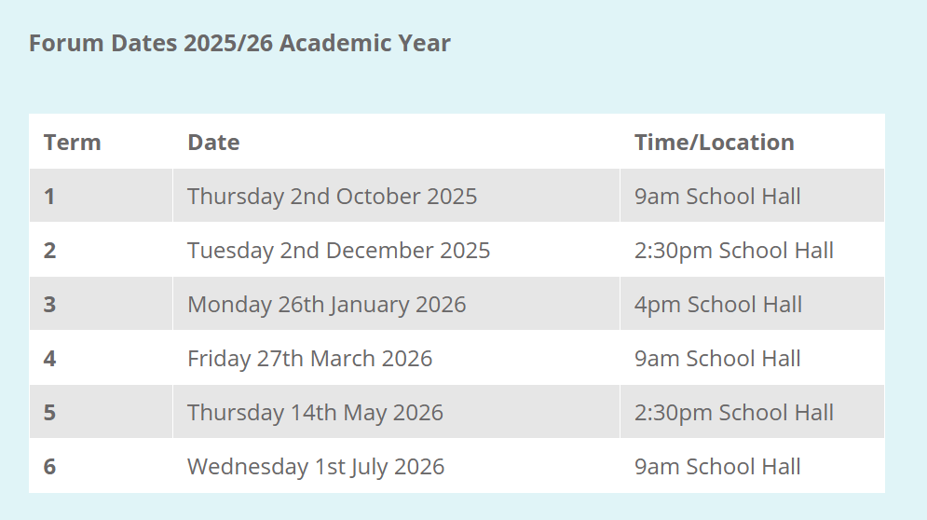

Slide 3
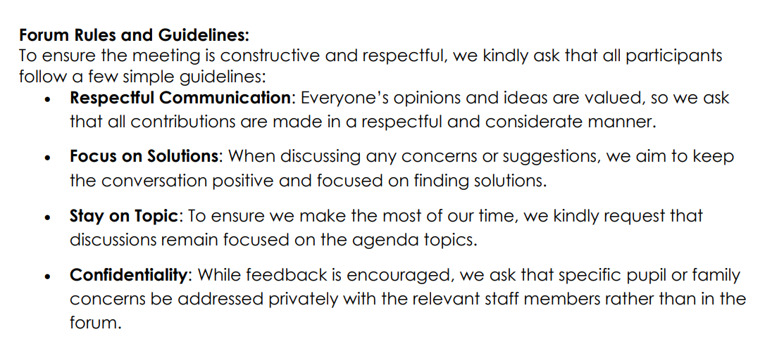

Slide 4
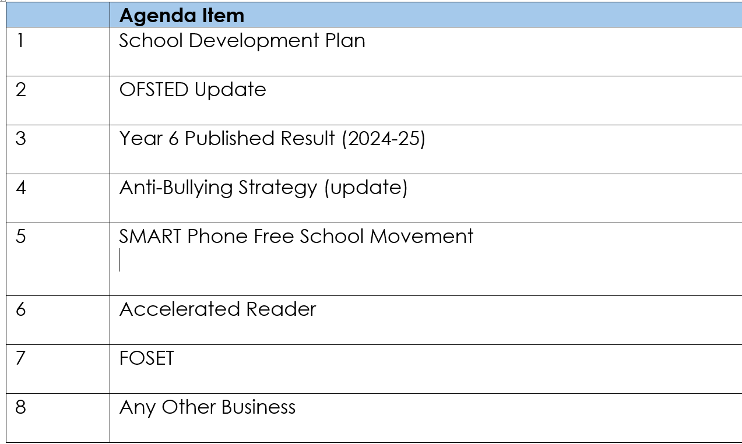


Slide 5
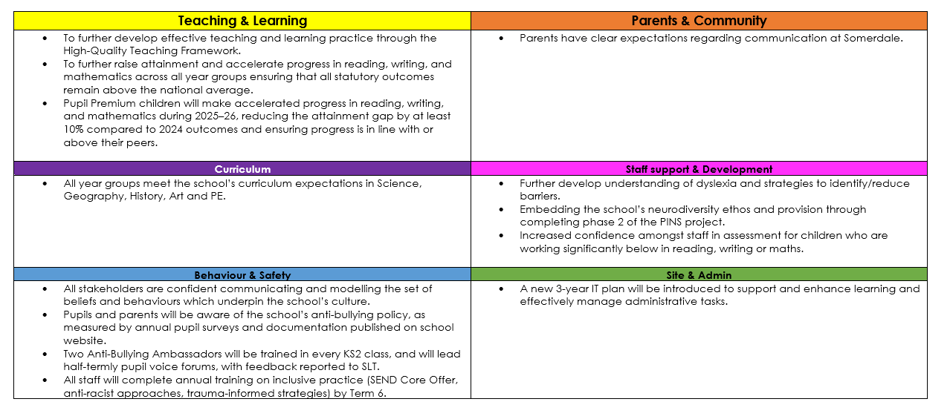
Somerdale Educate Together Development Plan 2025/2026

Slide 6

New Inspection Framework
Inclusion
Curriculum and teaching
Achievement
Attendance and behaviour
Personal development and wellbeing
Early years
Leadership and governance

Slide 7

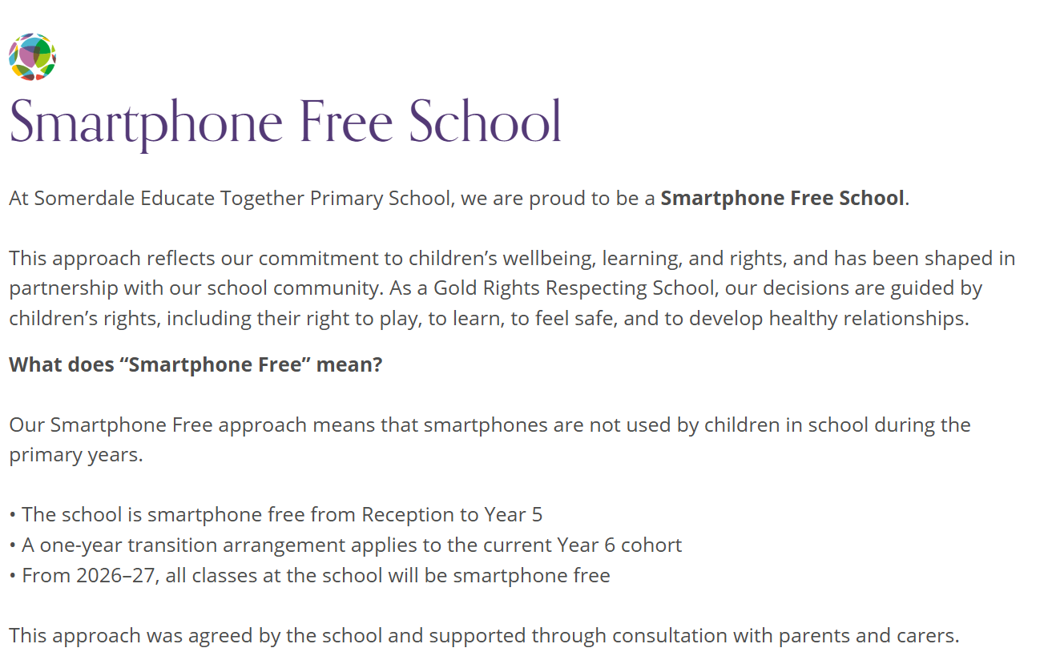
https://www.somerdaleet.org.uk/school-information/smartphone-free/

Slide 8
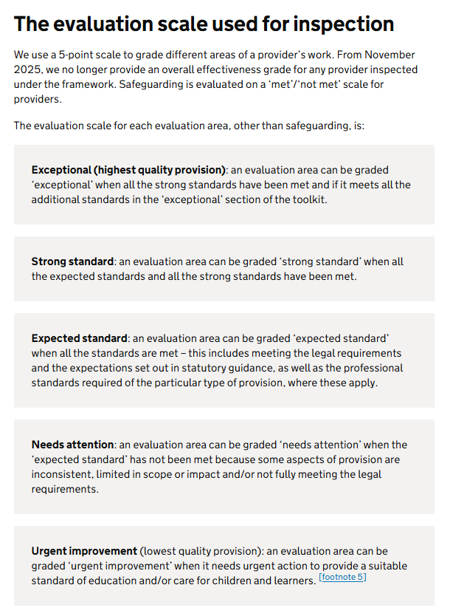
New Inspection
Framework

Slide 9
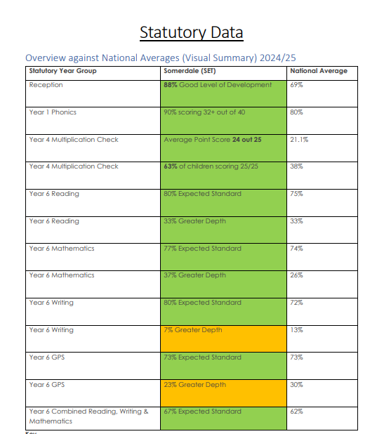
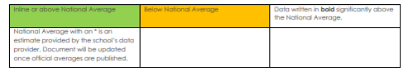

Slide 10
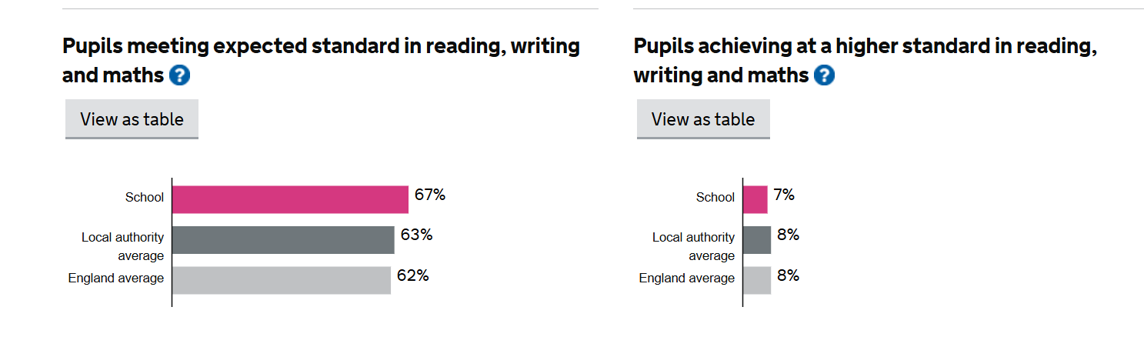
https://www.compare-school-performance.service.gov.uk/school/144762/somerdale-educate-together-primary-academy/primary/results-over-time

Slide 11
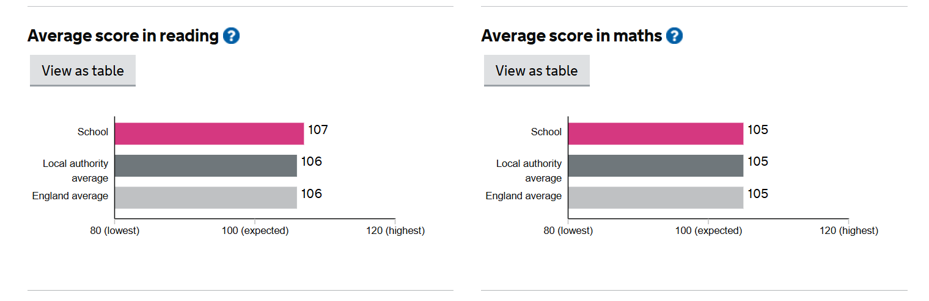

Slide 12
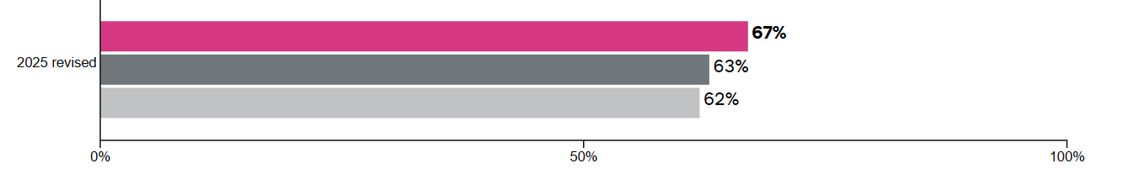
Reading, Writing and Maths Combined

Slide 13


https://www.somerdaleet.org.uk/school-information/anti-bullying-approach/

Slide 14
Accelerated Reader
With an extensive library of books and interactive quizzes, Accelerated Reader offers primary schools the following advantages:
Personalised reading practice: Pupils are matched with books at their appropriate reading level, enabling them to progress at their own pace and build confidence.
Enhanced reading comprehension: By taking quizzes on books they have read, pupils develop critical reading comprehension skills, while teachers gain insights into individual progress and can provide targeted instruction.
Motivation and reward: Accelerated Reader incorporates a motivating reward system that celebrates pupils’ reading achievements, fostering a positive reading culture and encouraging them to set and achieve their reading goals.
Data-driven insights: Teachers and school administrators gain valuable data on pupils’ reading habits, comprehension levels, and progress, enabling them to make informed decisions, identify struggling readers, and evaluate the effectiveness of literacy programs.

Slide 15


Slide 16
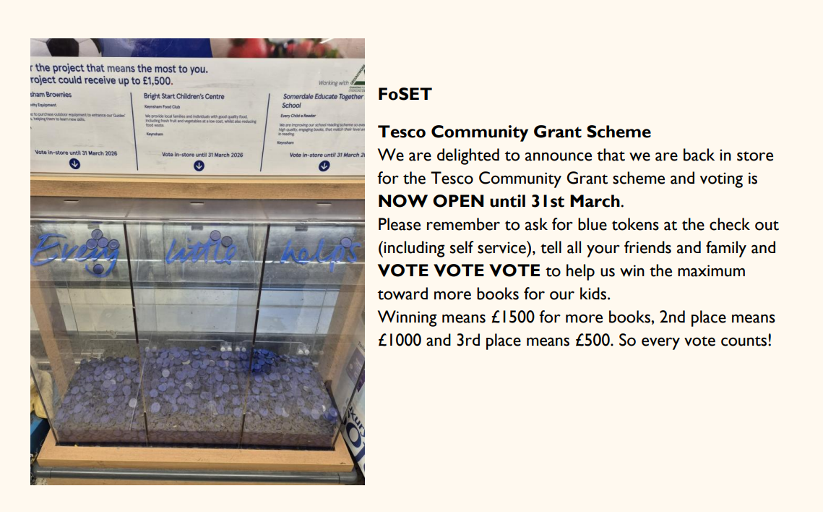
Tesco Community Grant Scheme

Slide 17


Slide 18
